Slide 1
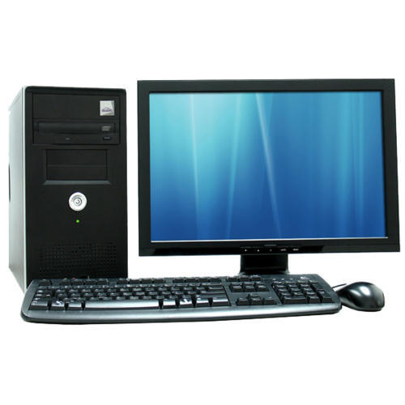
COMPUTER
A computer is a device that can be instructed to carry out arbitrary sequences of arithmetic or logical operations automatically.
Computer Software:
Computer software is a part of a computer system that consists of data or computer instructions, in contrast to the physical hardware from which the system is built.
Computer Hardware:
Computer hardware is the collection of physical parts of a computer system. This includes the monitor, keyboard, and mouse.

Slide 2
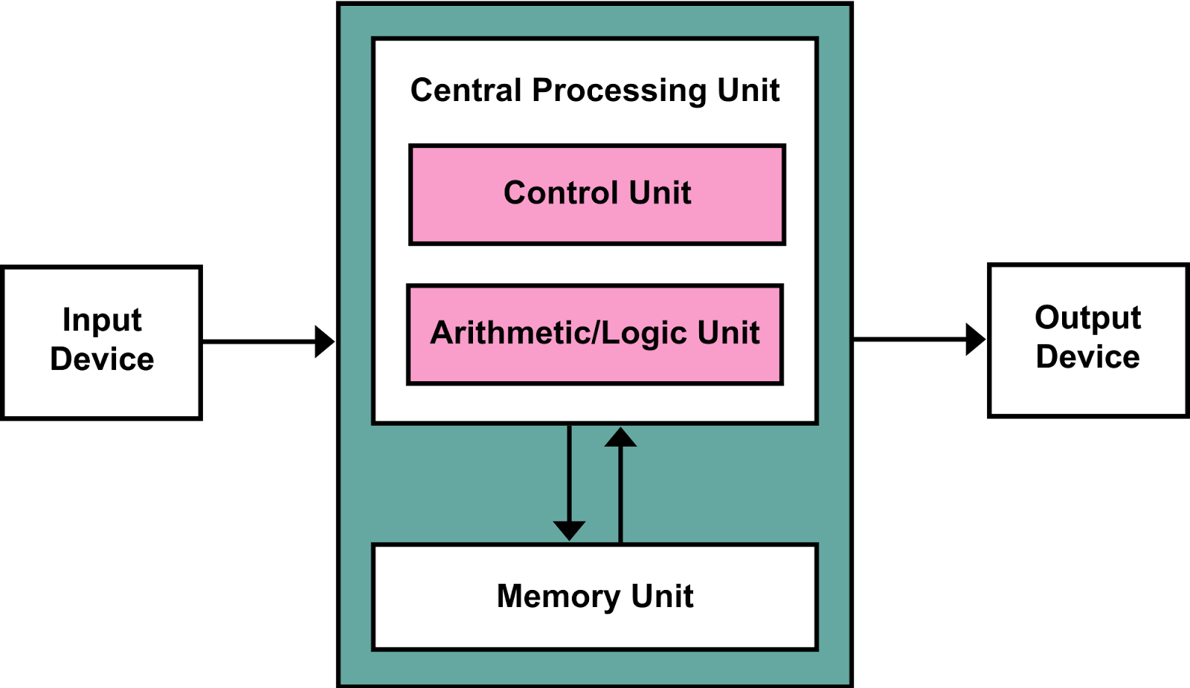
Block Diagram of a Computer

Slide 3
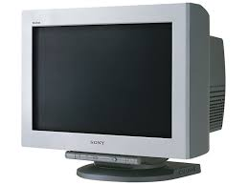
COMPUTER MONITORS
A Computer Monitor is an output device which displays information in pictorial form.
It usually comprises the display device, circuitry, casing and power supply.
Modern computer monitors are easily interchangeable with conventional sets.

Slide 4
Technologies
Multiple technologies have been used for computer monitors. Those are
Cathode ray tube(CRTs) : The first computer monitors used CRTs in 1970s. It was common for a video display terminal(VDT) usng a CRT to be physically integrated with a keyboard and other components of the system.
Liquid crystal display(LCD) : Throughout the 1990s, the primary use of LCD technology as computer monitors was in laptops where the lower power consumption, lighter weight and smaller physical size of LCD’s justified the higher price versus a CRT.
Example : TFT- LCD
Organic light-emitting diode(OLED) : Monitors provide higher contrast and better viewing angles than LCDs but they require more power when displaying documents with white or bright backgrounds.

Slide 5
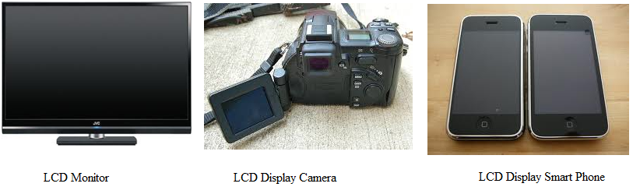
Working principle
LCD (Liquid Crystal Display):
LCD technology is used for displaying the image in notebook or some other electronic devices like mini computers.
The LCD works on the principle of blocking light. While constructing the LCD’s, a reflected mirror is arranged at the back.

Slide 6
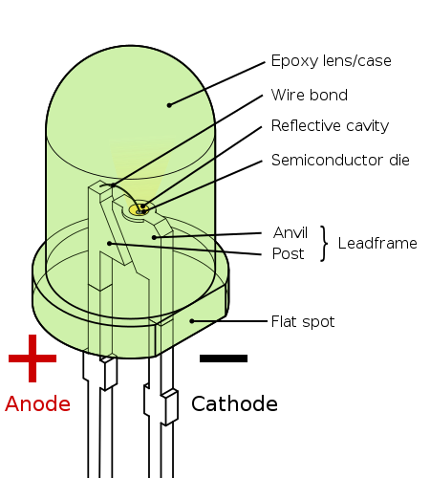
Light-Emitting Diode (LED)
A light-emitting diode (LED) is a semiconductor device that emits visible light when an electric current passes through it.

Slide 7
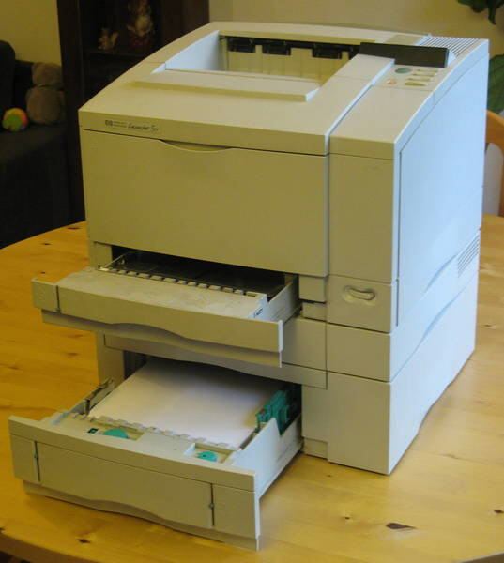
PRINTERS
A printer is a device that accepts text and graphic output from a computer and transfers the information to paper, usually to standard size sheets of paper.
Printers vary in size, speed, sophistication, and cost.
The first electronic printer was the EP-101 in 1968
In general, more expensive printers are used for higher-resolution color printing.
Laser printers using PostScript mixed text and graphics, like dot-matrix printers, but at quality levels formerly available only from commercial typesetting systems.

Slide 8
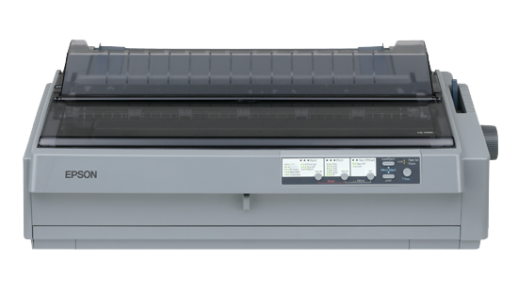
Types of printers
Impact printers: An impact printer makes contact with the paper. It usually forms the print image by pressing an inked ribbon against the paper using a hammer or pins.
Its types are:
Dot matrix printers
Daisy-wheel printers
Line printers
Drum printer
Chain printers
Band printers
Non- impact printers: Non-impact printers do not use a striking device to produce characters on the paper; and because these printers do not hammer against the paper they are much quieter.
Its types are:
Ink-jet printers
Laser printers

Slide 9
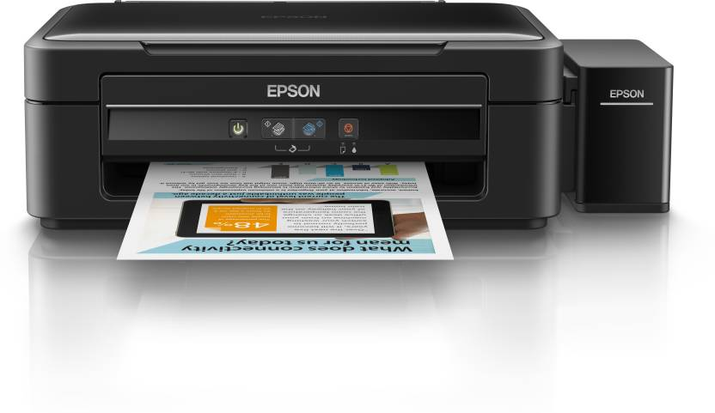
Working principle
Ink-jet printers:
Inkjet printers were really an evolution of dot-matrix printers. Instead of metal needles, they use hundreds of tiny guns to fire dots of ink at the paper instead.
The characters they print are still made up of dots, just like in a dot-matrix printer, but the dots are so very tiny that you cannot see them.
Different types of inkjet printer fire the ink in various ways.
Ex: Canon, Epson

Slide 10
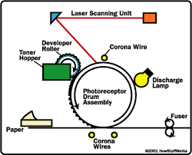
Laser printer:

Slide 11
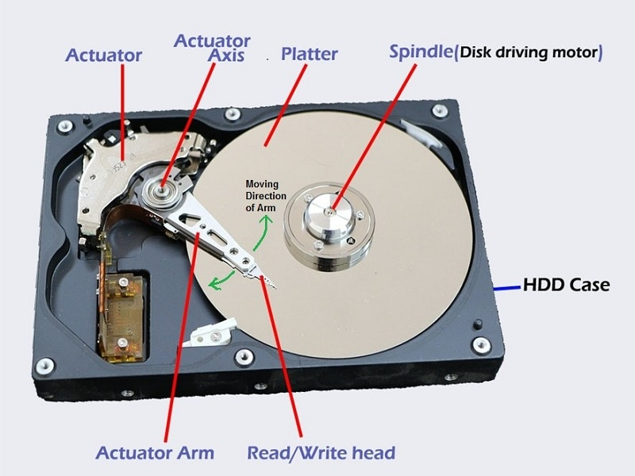
HARD DISK
Hard Disk of our computer store our data and also store the operating system of any computer.

Slide 12
Key Components of a Hard Drive
Platter
Read-Write Heads
Actuator
Spindle
PCB (Printed Circuit Board)

Slide 13
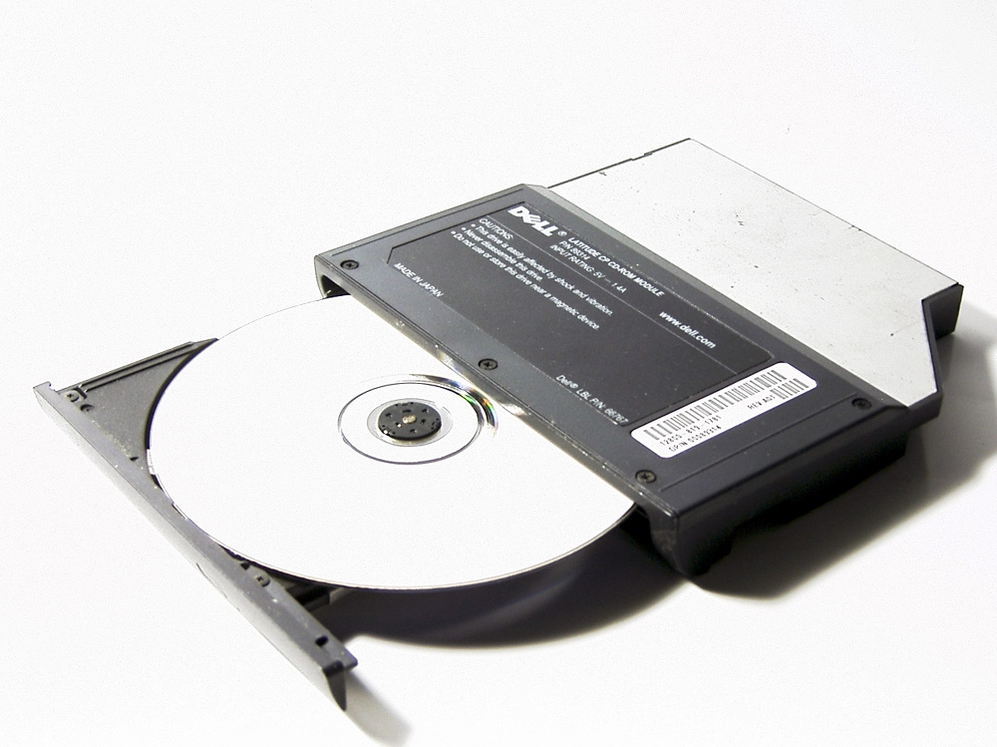
CD- ROM
A CD-ROM is a optical compact disc which contains data. The acronym which stands for "Compact Disc- Read Only Memory". Computers can read CD-ROMs, but cannot write to CD-ROMs, which are not writable or erasable.

Slide 14
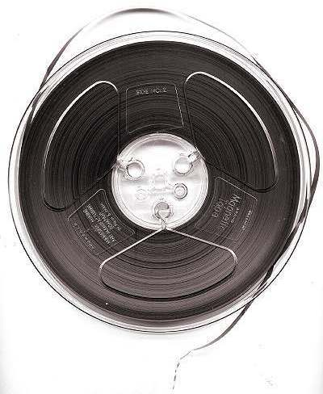
Magnetic Tapes
Magnetic tape is a medium for magnetic recording, made of a thin, magnetizable coating on a long, narrow strip of plastic film.
Devices that record and play back audio and video using magnetic tape are tape recorders and video tape recorders.
A device that stores computer data on magnetic tape is known as a tape drive.

